Slide 1
Groups & Team management
Session 12
30th June, 2026

Slide 2
What Is a Group?
A group is defined as two or more interacting and interdependent individuals who come together to achieve particular goals.
Groups can either be formal or informal.
Formal groups are work groups established by the organization that have designated work assignments and specific tasks.
In formal groups, appropriate behaviors are established by and directed toward organizational goals.
Informal groups are social. These groups occur naturally in the workplace in response to the need for social contact. Informal groups tend to form around friendships and common interests

Slide 3
Examples of formal groups
Command groups. These are the basic, traditional work groups determined by formal authority relationships and depicted on the organizational chart. They typically include a manager and those employees who report directly to him or her.
Cross-functional teams. These bring together the knowledge and skills of individuals from various work areas in order to come up with solutions to operational problems. Cross-functional teams also include groups whose members have been trained to do each other's jobs.
Self-managed teams. These are essentially independent groups that, in addition to doing their operating jobs, take on traditional management responsibilities such as hiring, planning and scheduling, and performance evaluations.
Task forces. These are temporary groups created to accomplish a specific task. Once the task is complete, the group is disbanded.

Slide 4
Stages of Group Development
Group development is a dynamic process.
Most groups are in a continual state of change.
Five stages are forming, storming, norming, performing, and adjourning

Slide 5
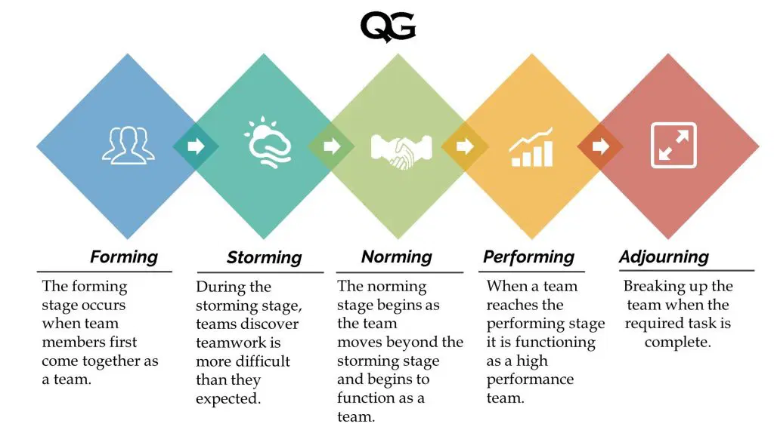

Slide 6
Forming: First, people join the group either because of a work assignment, in the case of a formal group, or for some other benefit desired (such as status, self-esteem, affiliation, power, or security), in the case of an informal group. Second is the task of defining the group's purpose, structure, and leadership.
Storming: is one of intragroup conflict. Members accept the existence of the group but resist the control that the group imposes on individuality. Furthermore, there is conflict over who will control the group.

Slide 7
Norming: close relationships develop and the group demonstrates cohesiveness. There's now a strong sense of group identity and camaraderie. This stage is complete when the group structure solidifies and the group has assimilated a common set of expectations of what defines correct member behavior
Performing: The group structure at this point is fully functional and accepted. Group energy has moved from getting to know and understand each other to performing the task at hand.
Adjourning: Temporary groups—such as committees, task forces, and similar groups—that have a limited task to perform. In this stage, the group prepares to disband.

Slide 8
Basic group concepts
Roles: refers to a set of expected behavior patterns attributed to someone who occupies a given position in a social unit.
In a group, individuals are expected to perform certain roles because of their position in the group.
These roles tend to be oriented toward either task accomplishment or maintaining group member satisfaction.
When that individual is confronted by different role expectations, he or she experiences role conflict.

Slide 9
Norms and Conformity
All groups have established norms, or acceptable standards or expectations that are shared by the group's members.
Norms dictate factors such as work output levels, absenteeism, promptness, and the amount of socializing allowed on the job.
Group norms that push us toward conformity.
We desire to be one of the group and to avoid being visibly different.
We can generalize further to say that when an individual's opinion of objective data differs significantly from that of others in the group, he or she feels extensive pressure to align his or her opinion to conform with the opinions of others.

Slide 10
Status systems
Status is a prestige grading, position, or rank within a group.
Status is a significant motivator and has behavioral consequences when individuals see a disparity between what they perceive their status to be and what others perceive it to be
Status in a group may be informally conferred by characteristics such as education, age, skill, or experience.
Status is also formally conferred on account of hierarchical standing in the organization

Slide 11
Group Size
Small groups are faster at completing tasks than are larger ones. However, if the group is engaged in problem solving, large groups consistently get better results than smaller ones
Free rider tendency: as groups get incrementally larger, the contribution of individual members often tends to decrease. The dispersion of responsibility within a group encourages individuals to slack off.

Slide 12
Group Cohesiveness
It is the degree to which members are attracted to a group and share the group's goals
Highly cohesive groups are more effective than are less cohesive ones
The more cohesive a group is, the more its members will follow its goals.
If the goals are desirable (for instance, high output, quality work, cooperation with individuals outside the group), a cohesive group is more productive than a less cohesive group.
But if cohesiveness is high and attitudes are unfavorable, productivity decreases.
If cohesiveness is low and goals are supported, productivity increases but not as much as when both cohesiveness and support are high.
When cohesiveness is low and goals are not supported, cohesiveness has no significant effect on productivity.

Slide 13
Conflict Management
Conflicts are defined as perceived incompatible differences resulting in some form of interference or opposition. If people in a group perceive that differences exist, then there is conflict.

Slide 14
3 views of conflict
Traditional view: conflict must be avoided because it indicates a problem within the group.
Human relations view: conflict is a natural and inevitable outcome in any group and need not be negative but, rather, has potential to be a positive force in contributing to a group's performance
Interactionist view: Not only can conflict be a positive force in a group but also that some conflict is absolutely necessary for a group to perform effectively.
Some conflicts are seen as supporting the goals of the work group and improving its performance; these are functional conflicts of a constructive nature.
Other conflicts are destructive and prevent a group from achieving its goals. These are dysfunctional conflicts.

Slide 15
Conflict and Group performance
Level of conflict | Low or none | Optimal | High
Type of conflict | Dysfunctional | Functional | Dysfunctional
Group’s internal characteristics | Apathetic Stagnant Unresponsive to change Lack of new ideas | Viable Self-critical Innovative | Disruptive Chaotic Uncooperative
Level of group performance | Low | High | Low

Slide 16
What differentiates Dysfunctional from Functional conflict?
Task conflict relates to the content and goals of the work.
Relationship conflict focuses on interpersonal relationships. They are almost always dysfunctional. Because the friction and interpersonal hostilities inherent in relationship conflicts increase personality clashes and decrease mutual understanding, thereby hindering the completion of organizational tasks
Process conflict refers to how the work gets done.
Low levels of process conflict and Low to moderate levels of task conflict are functional

Slide 17
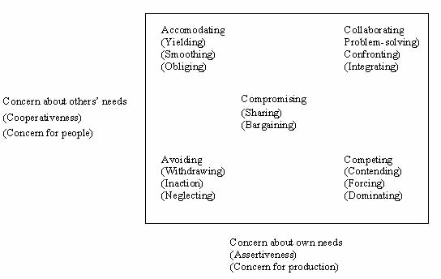
Conflict-resolution options

Slide 18
Group Decision Making-Advantages
Provide more complete information. A group brings a diversity of experience and perspectives to the decision process that an individual cannot.
Generate more alternatives. Because groups have a greater amount and diversity of information, they can identify more alternatives than an individual. This advantage is particularly evident when group members represent different areas of expertise. For instance, a team made up of individuals from engineering, accounting, production, marketing, and human resources will generate alternatives that reflect their diverse perspectives.
Increase acceptance of a solution. Group members are reluctant to fight or undermine a decision they have helped develop.
Increase legitimacy. The group decision-making process is consistent with democratic ideals, and decisions made by groups may be perceived as more legitimate than decisions made unilaterally by one person.

Slide 19
Group decision making-Disadvantages
Time consuming. Groups almost always take more time to reach a solution than it would take an individual.
Minority domination. Members of a group are never perfectly equal. They may differ in organizational rank, experience, knowledge about the problem, influence with other members, verbal skills, assertiveness, and so forth. This inequality creates the opportunity for one or more members to dominate others. A dominant and vocal minority frequently can have an excessive influence on the final decision.
Pressures to conform. There are pressures to conform in groups. This can lead to a phenomenon known as groupthink, which is a type of conformity in which group members withhold different or unpopular views in order to give the appearance of agreement. Groupthink undermines critical thinking in the group and eventually harms the quality of the final decision.
Ambiguous responsibility. Group members share responsibility, but who is actually responsible for the final outcome? In an individual decision, it's clear who is responsible. In a group decision, the responsibility of any single member is diluted.

Slide 20
Techniques for more creative group decision-making
Electronic meetings: Decision-making groups that interact by using linked computers
Brainstorming: An idea-generating process encourages alternatives while withholding criticism
Nominal Group Technique (NGT): A group decision-making technique in which group members are presented with a problem; each member independently writes his or her ideas on the problem; and then each member presents one idea to the group until all ideas have been presented. No discussion takes place until all ideas have been presented.

Slide 21
Determinants of work group behavior
External Conditions Imposed on the Group: include the organization's overall strategy, authority structures, formal regulations, availability or absence of organizational resources, employee selection criteria, the organization's performance management system, the organization's culture, and the general physical layout of the group's work space
Group Member Resources: include members' abilities and personality characteristics

Slide 22
Group Structure: include roles, norms, status, group size, and leadership.
Group Processes: include the communication patterns used by members to exchange information, group decision processes, leader behavior, power dynamics, conflict interactions, and the like
Group Tasks: Tasks can be generalized as being either simple or complex. Simple tasks are routine and standardized. Complex tasks are ones that tend to be novel or nonroutine.

Slide 23
What Is a Team?
They are formal groups made up of interdependent individuals who are responsible for the attainment of a goal

Slide 24
Categories of Teams
Purpose Product Development Problem solving Reengineering Any other organizational purposes desired | Structure Supervised Self-managed
Membership Functional Cross-functional | Duration Permanent Temporary

Slide 25
Types of Teams
Permanent teams: Departmental teams and others that are part of the organization's formal structure
Temporary teams: include task forces, project teams, problem-solving teams, and any other type of short-term team formed to develop, analyze, or study a work-related issue

Slide 26
Functional teams: A departmental team is functional because its members come from a specific functional area.
Cross-functional teams: are a way to foster innovation, cooperation, and commitment.
Supervised teams: will be under the direction of a manager who is responsible for guiding the team in setting goals, performing the work activities, and evaluating performance.
Self-managed team: assumes the responsibilities of managing itself.
Virtual teams: are teams that use computer technology to link physically dispersed members in order to achieve a common goal

Slide 27
Characteristics of effective teams
Clear goals: High-performance teams have both a clear understanding of the goals to be achieved and a belief that the goals embody important results
Relevant skills: Effective teams are composed of competent individuals. They have the necessary technical and interpersonal skills to achieved the desired goals while working well together.
Mutual trust: members believe in the ability, character, and integrity of each other.

Slide 28
How to further trust among managers?
Communicate. Keep team members and subordinates informed by explaining decisions and policies and providing accurate feedback. Be candid about your own problems and limitations.
Be supportive. Be available and approachable. Encourage and support team members' ideas.
Be respectful. Delegate real authority to team members and listen to their ideas.
Be fair. Give credit where it's due, be objective and impartial in performance evaluations, and be generous with your praise.
Be predictable. Be consistent in your daily affairs. Make good on your explicit and implied promises.
Demonstrate competence. Develop the admiration and respect of team members by demonstrating technical and professional ability and good business sense.

Slide 29
Unified Commitment: Members of an effective team exhibit intense loyalty and dedication to the team. They're willing to do whatever it takes to help their team succeed
Good Communication: e teams are characterized by good communication. Members convey messages between each other in ways that are readily and clearly understood. This includes nonverbal as well as spoken messages
Negotiating Skills: Effective teams, on the other hand, tend to be flexible and are continually making adjustments in who does what. This flexibility requires team members to possess negotiating skills.

Slide 30
Appropriate Leadership: Effective leaders can motivate a team to follow them through the most difficult situations. How? They help clarify goals. They demonstrate that change is possible by overcoming inertia. And they increase the self-confidence of team members, helping members to more fully realize their potential.

Slide 31
Internal and External Support: The final condition necessary for an effective team is a supportive climate. Internally, the team should have a sound infrastructure. This includes proper training, a clear and reasonable measurement system that team members can use to evaluate their overall performance, an incentive program that recognizes and rewards team activities, and a supportive human resource system.
The right infrastructure should support members and reinforce behaviors that lead to high levels of performance.
Externally, managers should provide the team with the resources needed to get the job done.

Slide 32
Managing Teams
Planning
Goal determination is an important part of the planning process.
Effective teams have clear goals.
It's important that team members understand and accept the team's goals

Slide 33
Organizing:
Organizing tasks in managing a team include clarifying authority and structural issues.
Leading:
A team must address include, among others, what role the leader will play, how disagreements will be handled, and what communication processes will be used
Controlling
Two important controlling issues are: How will the team's performance be evaluated, and what type of reward system will be used?

